Slide 1

Company One-Pagers
Teaching Module
Dane A. Boysen
January 30, 2017

Slide 2
Module Contents
Overview
One-Pager Content
One-Pager Format
Check List
Examples
Reading Materials

Slide 3
1
Overview

Slide 4
Company One-Pagers
Overview
A short company one-pager is essential for a start-up company, particular when raising money.
It should provide a brief synopsis of your company pitch deck, all within one-page (front and back).
The advice provided in this module is specific to early-stage hardtech start-up companies

Slide 5
2
One-Pager Content

Slide 6
One-Pager
key elements
One Line Pitch
Problem
Solution
Market
Competitors
Competitive Advantage
Business Model
Founders, Team, and Advisors
Customer Traction
Key Milestones
Funding

Slide 7
1. One Line Pitch
describe your company in one sentence
The very first thing you want to explain is what your startup is doing. You should use a one-line pitch – a very effective scheme for that is:
[Company name] – the [xxx] of/for [xxx].
Montredo – the trusted online shop for luxury watches.
Plate Culture – the Airbnb of Food
LinkedIn – the social network for business
[Company name] is developing [a defined offering] to help [a defined audience] [solve a problem] with/by [secret sauce].
Montredo is developing an online shop to help watch-enthusiasts to buy watches safely online by sourcing the watches from authorized dealers only.
You can also use your very own technique for a good one-line pitch. Make sure your sentence is easy to understand though and describes what you are doing in a nutshell.

Slide 8
2. Problem
state the pain
Describe the problem that you are addressing.
Be precise, empiric and use actual data if it supports your cause of proving the existence and importance of the problem.

Slide 9
3. Solution
your product or service
Explain your product or service in an easy to understand way.
Focus on how you are going to solve the problem.
Strictly avoid self praises here.

Slide 10
4. Market
size and target
Give a short overview of the market, describing:
Your target customer – be as precise as possible by using demographics and motivators and try to draw a detailed profile of your typical users.
Market size of your target market – a measurement of the total volume of a given market in $.
Market growth of your target market – has the market been growing in the past years? Can further growth be expected? If yes, include this information as well.

Slide 11
5. Competitors
be honest
No matter what business you are in, you certainly have a few competitors.
Don’t try to cheat yourself or investors by denying your competition.
Be transparent; list 3-5 main competitors, including their strengths and weaknesses.
A matrix is a decent way to display your competition by comparing your startup with your main competitors over relevant variables.

Slide 12
6. Competitive Advantage
your unique selling proposition
What is your unique selling proposition?
What makes your startup unique and defensible?
What is your secret sauce that makes you better than anyone else?
Examples:
Patents
One of a kind technology
Market leader status
Strong brand recognition
Huge community

Slide 13
7. Business Model
how are you going to make money?
State how you are going to earn money: Subscription fees, commission on sales, etc.
What are your channels of distribution, how big is your gross margin?
If you are pre-revenue and unsure about monetization, state likely sources, price ranges and data from market surveys or customer interviews.
Depending on the business model, include important key performance indicators (KPIs) to better understand your business model and enable the investor to benchmark your case with other comparable startups.
Examples for KPIs to include in this section can be: gross margins, account sizes, sales cycles, repurchase rate, and customer lifetime value.

Slide 14
8. Founders, Team, and Advisors
the people who will execute the plan
No matter how great your product or service is – you need a dedicated and rockstar team to execute it.
Show the people behind the idea and describe their role in one sentence only.
If you or your team members have relevant past experiences also state them.
What if you don’t have a strong and diversified team yet?
What if you are still identifying key team members?
Be honest and explain which holes in the team you are going to fix: “CTO – candidates identified, to be hired in June 2015’’

Slide 15
9. Customer Traction
who is your customer?
Who is your first customer? Are you in discussions with them?
Do you have any joint development agreements, partnerships, etc.?
What do your target customers say about your product? Provide a quote.

Slide 16
10. Key Milestones
proof that you can deliver
Examples:
Secure government grant
Launch lab prototype
Close seed round
Close deal with company X

Slide 17
11. Funding
how much do you need and for what?
How much money are you trying to raise and how are you planning to use it?
Try to be as explicit as possible to show the investor that you have a well-elaborated plan on how you are actually going to use the money. It has proven to better use numbers rounded to the thousand (e.g. $ 123,000) than numbers rounded to the hundred thousands (e.g. $ 100,000).
Although a lot of startups do, we don’t recommend to mention the valuation in the one-pager as this number is likely going to change during the fundraising process and can also vary among different investors. You don’t want to change this section all the time and leave the investor curious to come back at you when he is interested and wants to know your “price”.

Slide 18
3
One-Pager Format

Slide 19
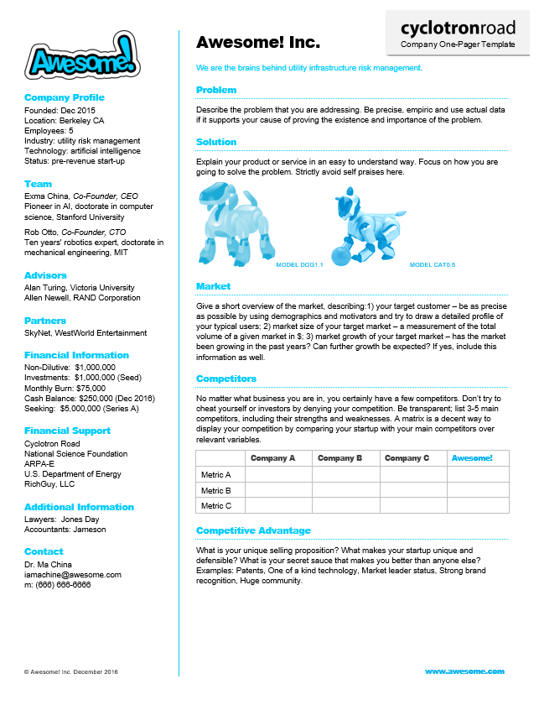
One-Pager Format
Left-side panel quick facts:
Logo
Company Profile
Location
Date Founded
Status
Team, Advisors, Partners
Industry
Website
Number of Employees
Financial Information
Financial Support
Contact Information

Slide 20




One-Pager Format
looks matter!
Once you have a preliminary design, try using an online design firm to prepare a final version – here are some resources we recommend that should cost about $100 bucks:
DesignCrowd - www.designcrowd.com
Upwork - www.upwork.com
Crowdspring - www.crowdspring.com
99designs - www.99designs.com

Slide 21
4
Check List

Slide 22
The Check List
Finally, in order to check if your one-pager is convincing and entertaining show it to at least 3 (critical) people from your network. Ask them if they would answer all of the following questions with a Yes:
Is there a real problem?
Is there an actual need for their solution and a sufficient market size?
Do they have a competitive advantage?
Are they going to make money and is the business model scalable?
Is the team capable of executing the plan?
Only send the one-pager out if it convinces your proof readers without any additional explanations.

Slide 23
5
Examples

Slide 24
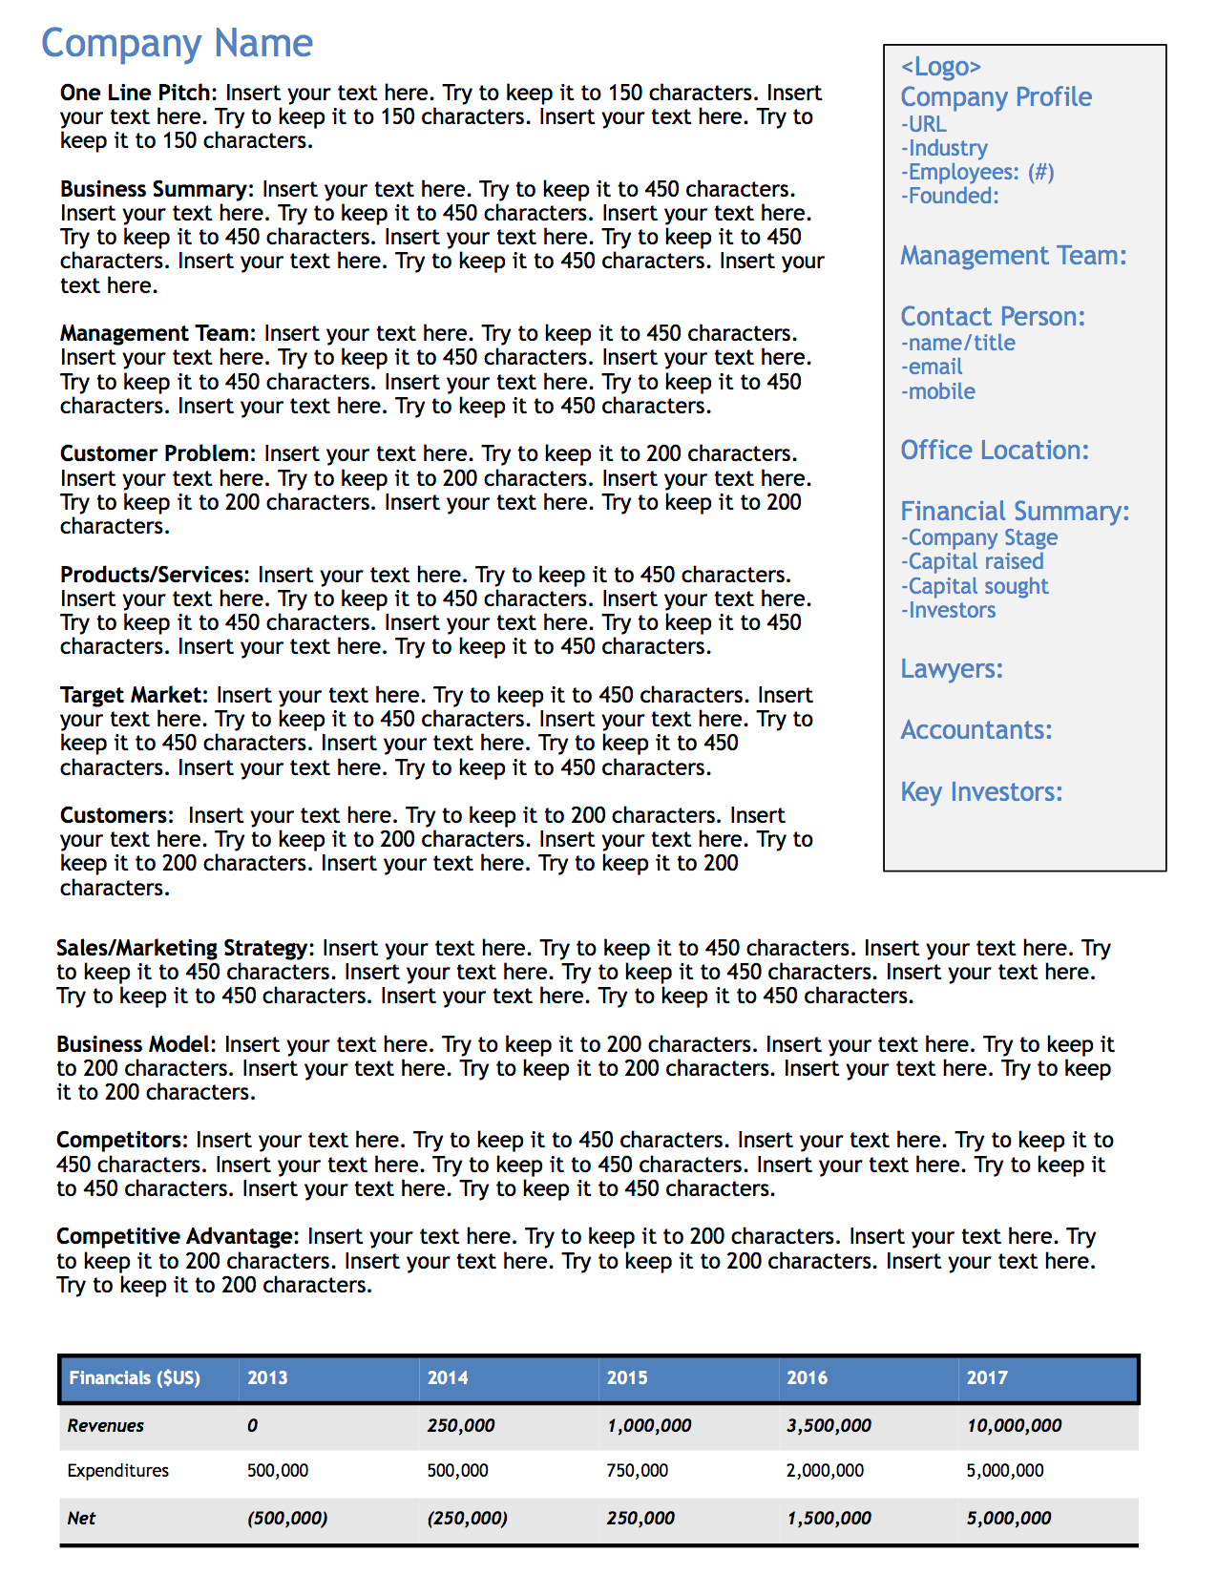
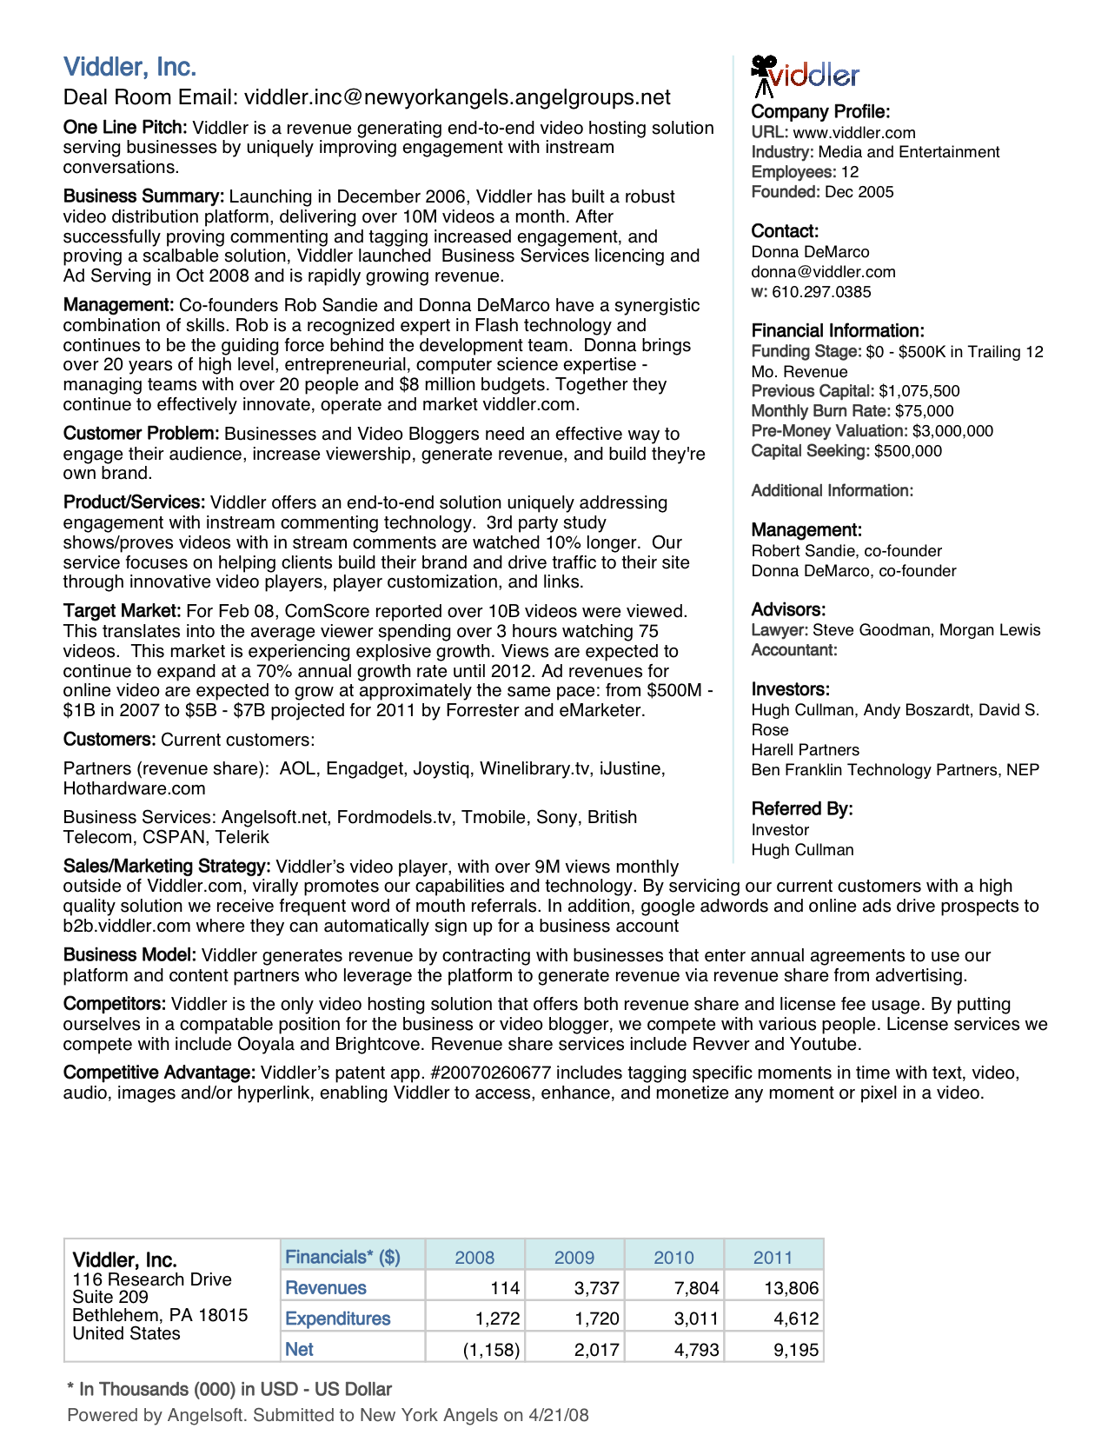

Slide 25
6
Reading Materials

Slide 26
Reading Materials
http://www.inc.com/christopher-mirabile/one-page-that-matters.html
http://failedexit.com/asset-guide/one-pager/
https://www.quora.com/What-should-I-include-on-a-one-pager-a-potential-investor-is-asking-for

